Slide 1

Meena Anantha Padmanabhan
Can science help the art of movie-making?

Slide 2

Problem Statement
Problem statement
A production company wants to select scripts for production based on the expected success of a movie
Questions
How do you define success?
What are the features that can be extracted from dialogues?
Notes:
Bring science into the art of movie making

Slide 3
Dataset
220,579 conversational exchanges between 10,292 pairs of movie characters
9,035 characters from 617 movies
304,713 total utterances
Movie metadata including: release year, IMDb rating, IMDb votes
Character metadata: gender, position on movie credits
IMDb Rating ranging from 1 through 10

Slide 4
Features obtained from the data
Counts: number of words, length of longest word, average word length, standard deviation of the length of words ,number of conversations, number of lines in a conversation, words per line, richness of the vocabulary
Part of Speech: frequency of different parts of speech
Punctuations: frequency of “?” and “!” marks
Mixture of genres: % of Topics represented in each movie
Sentiment metrics: count of +,-,neutral sentences

Slide 5
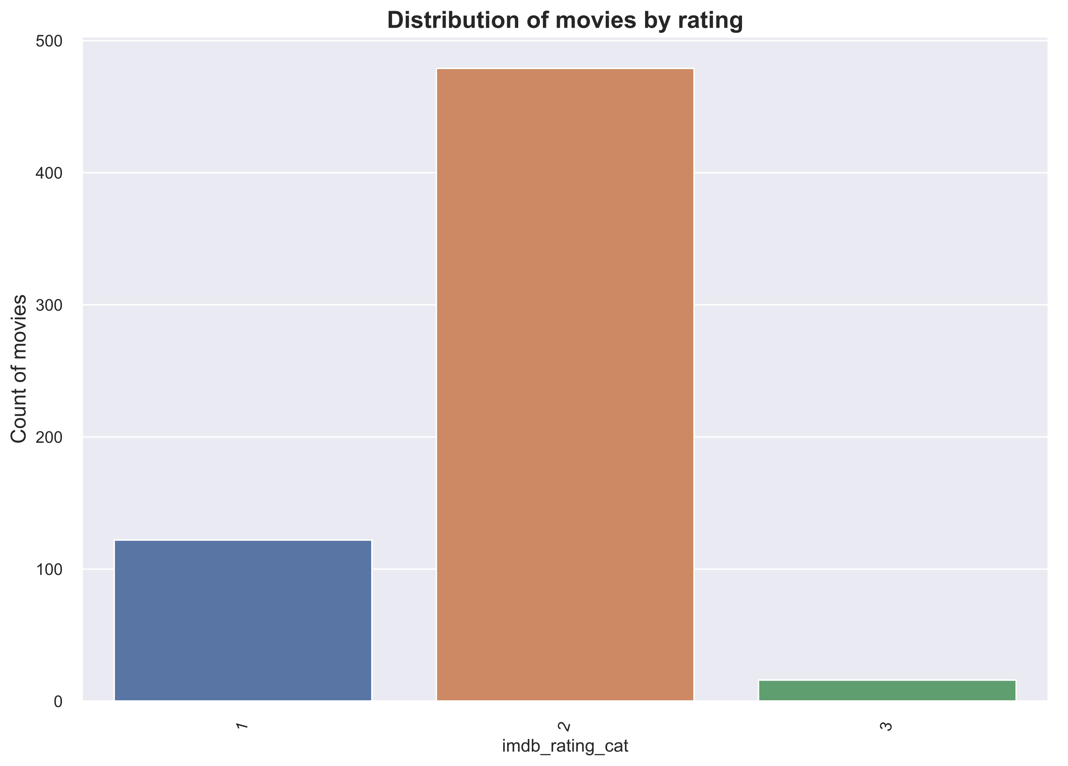
Distribution of IMDb Rating categories
There are 16 movies in the corpus that have a rating of lower than 4

Slide 6
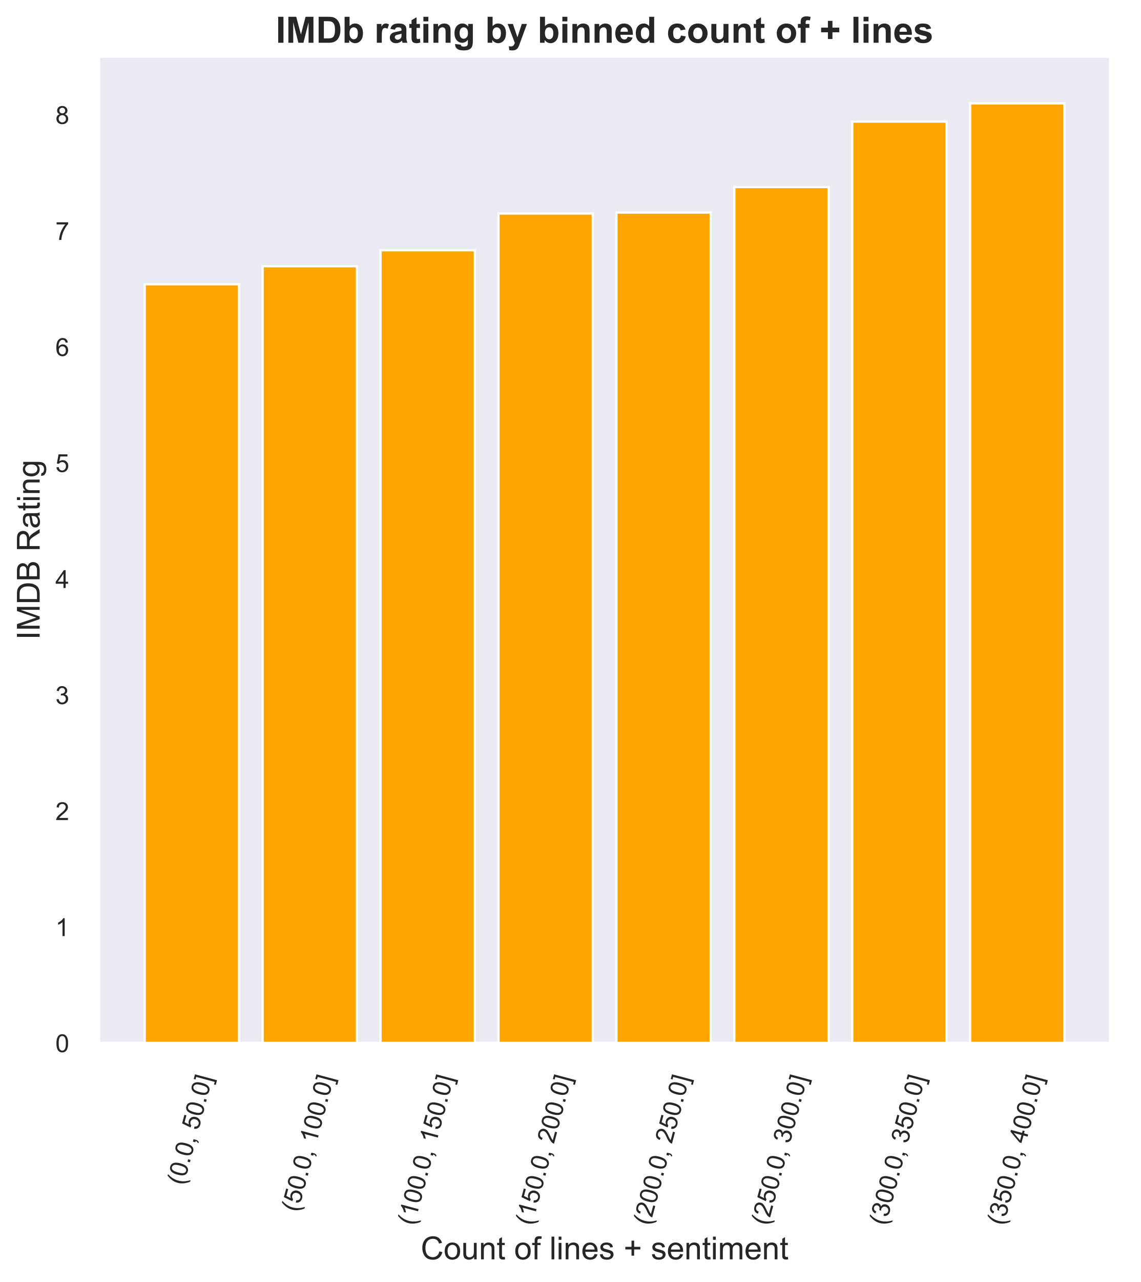
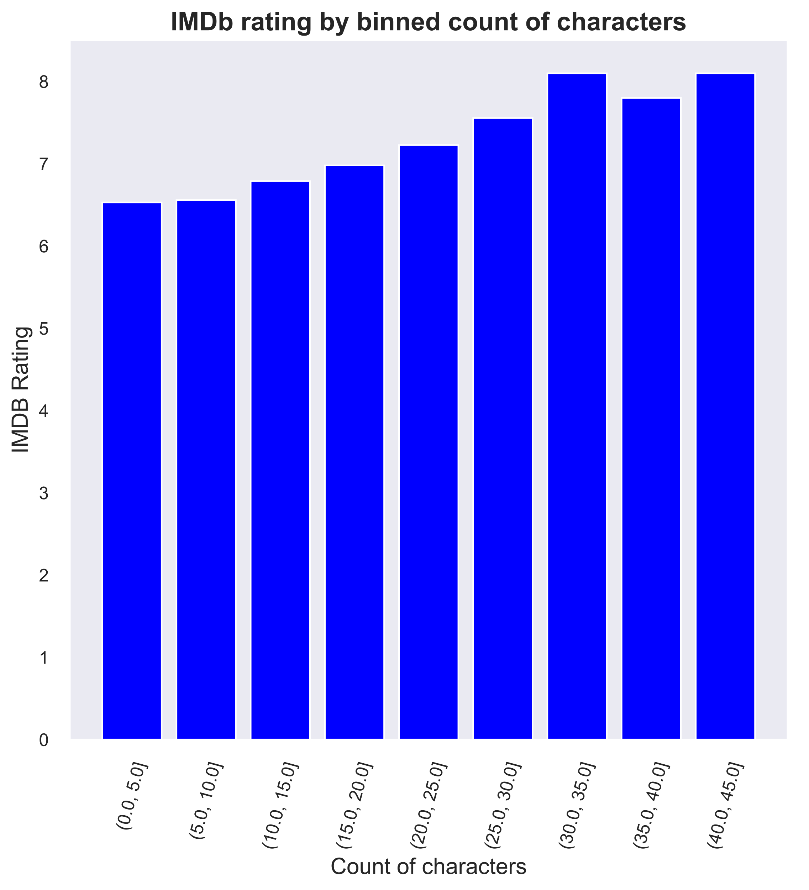
Exploratory Data Analysis
Cast size is positively correlated with IMDb rating
Movies with more positive lines tend to have higher ratings
Notes:
Need to change to proportion
Show the top 5 movies
Presence of exclamation marks

Slide 7
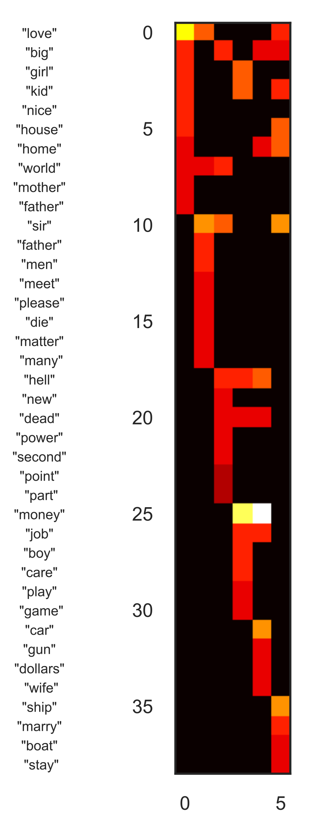
Distribution of topics in a movie did not impact the predictive power of the model
Six topics were used to describe the movies
The topics indicate overlapping themes
 | 1 | 2 | 3 | 4 | 5 | 6
1 | love | sir | world | money | money | ship
2 | big | love | hell | kid | car | sir
3 | girl | father | big | girl | hell | home
4 | kid | men | sir | job | job | house
5 | nice | meet | new | boy | gun | marry
6 | house | please | dead | care | dead | kid
7 | home | world | second | hell | big | love
8 | world | die | power | dead | home | boat
9 | mother | many | part | play | dollars | stay
10 | father | matter | point | game | kid | big
Notes:
6 different topics were used to identify the movie genres - 1 is family, 2 is romance, 5 is action, 6 is not sure.

Slide 8
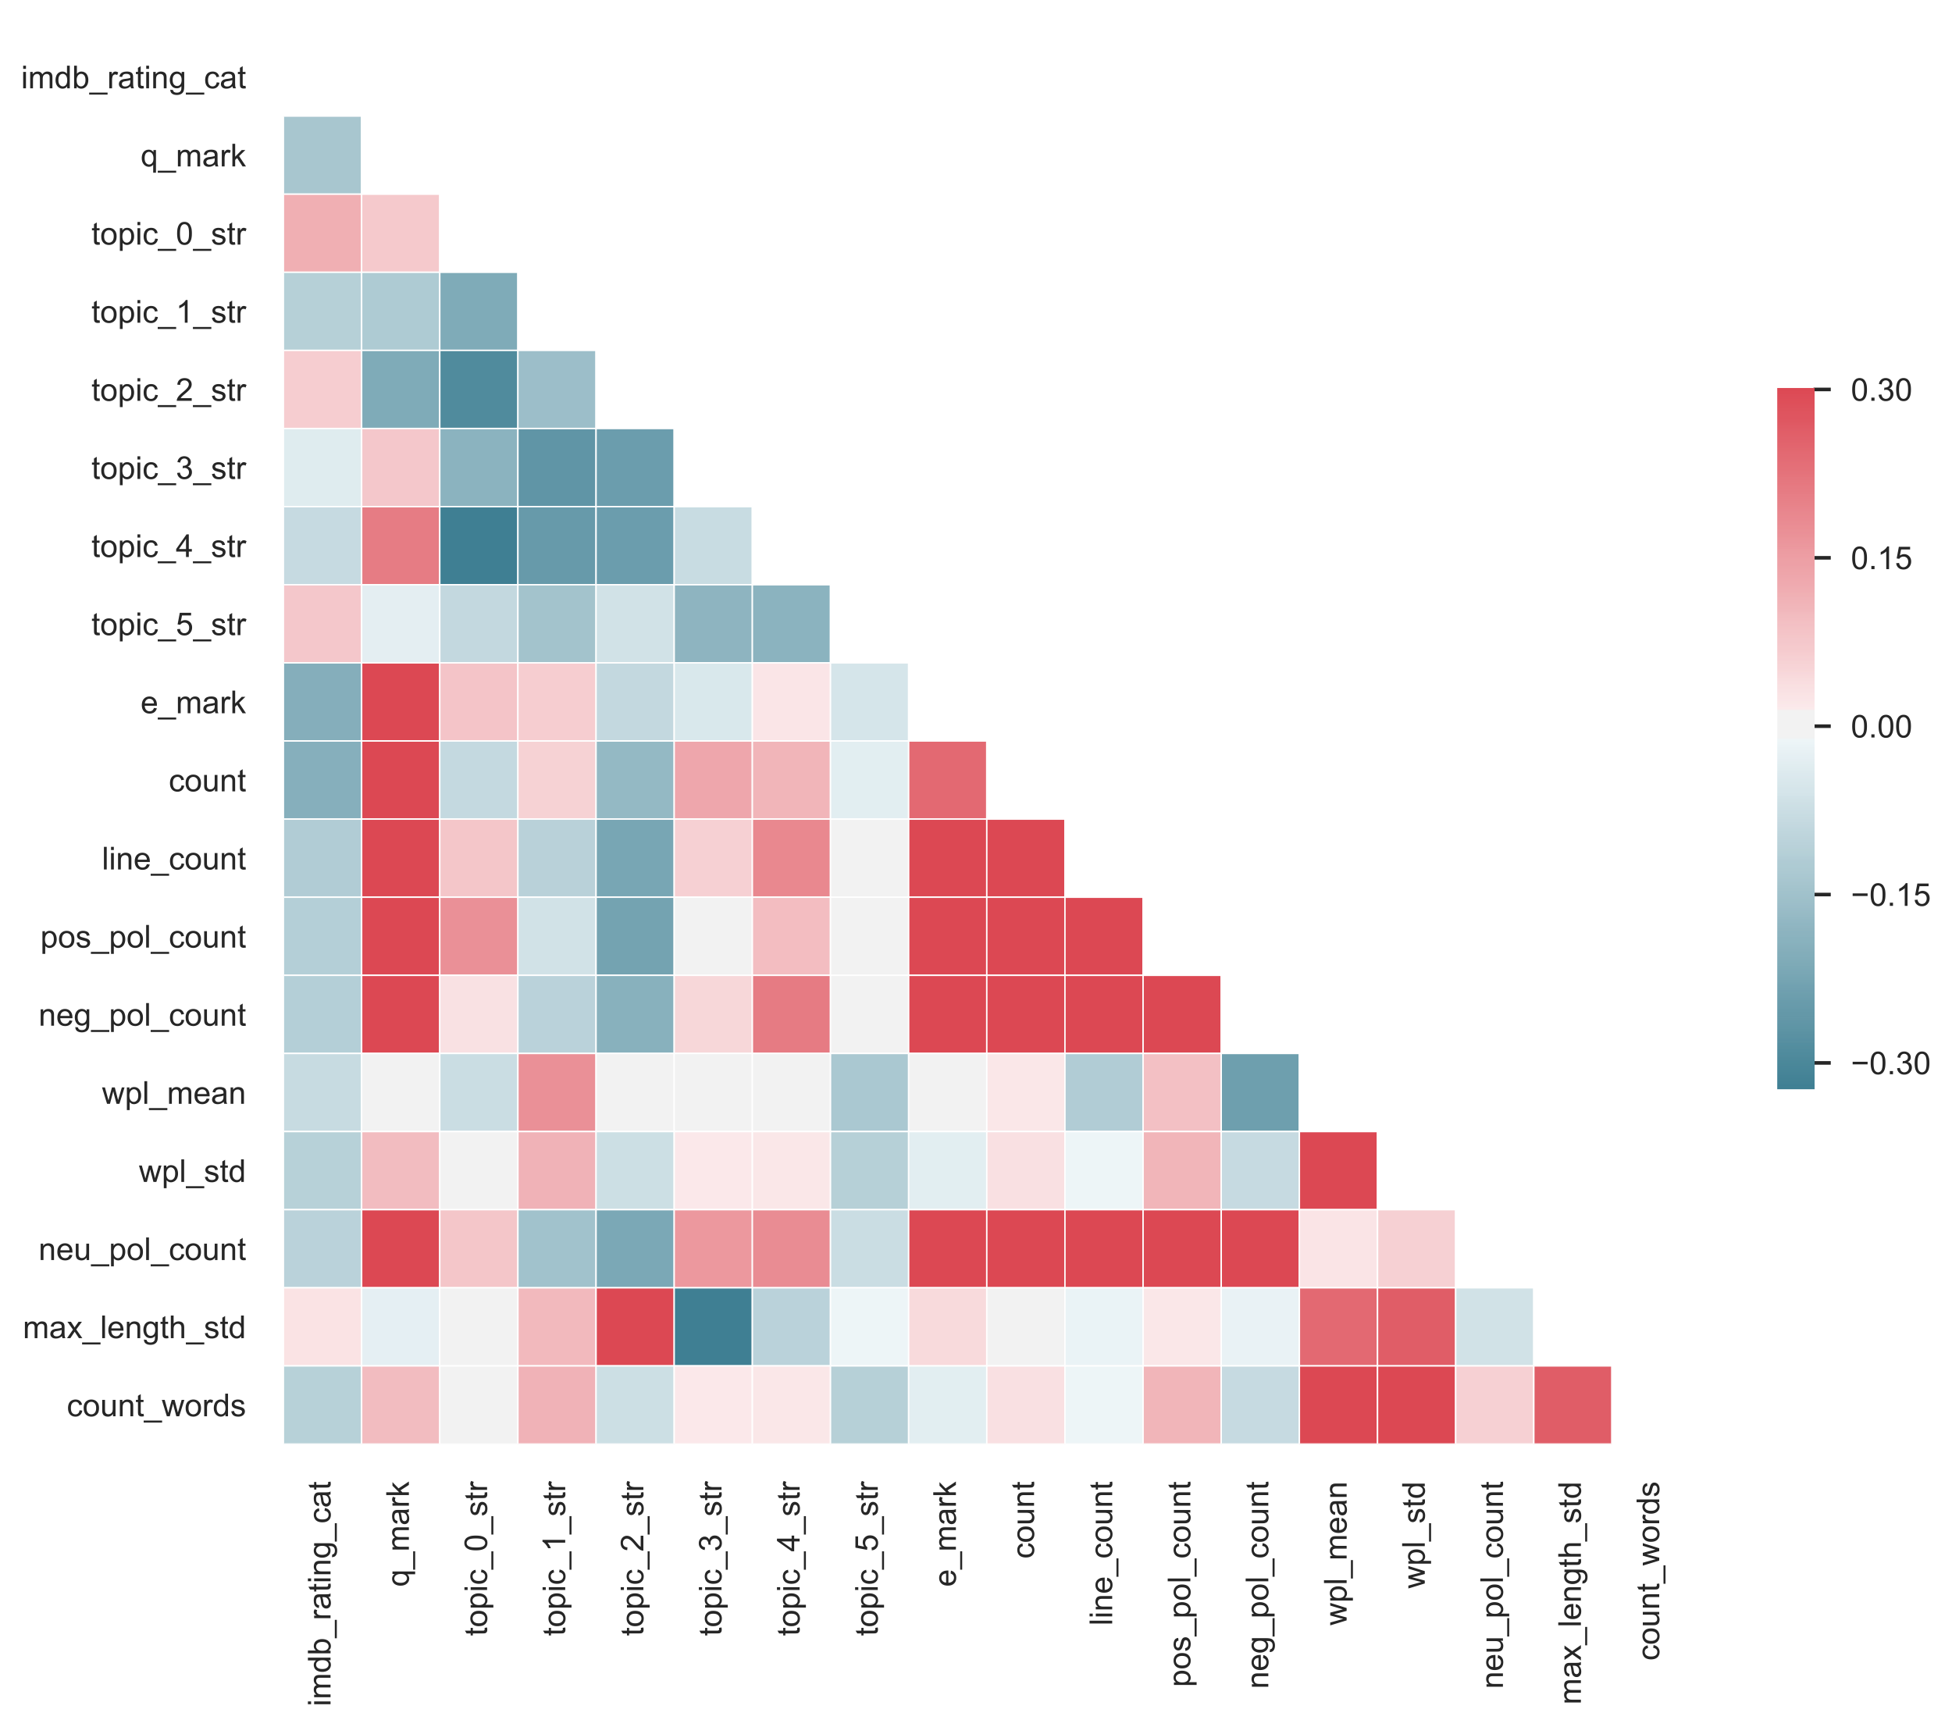
Correlation matrix
Notes:
The correlation matrix indicates that most of the variables are positively correlated with IMDb ratings. Topics are weakly correlated. Presence of exclamation mark, count of characters , line count have positive correlation.

Slide 9
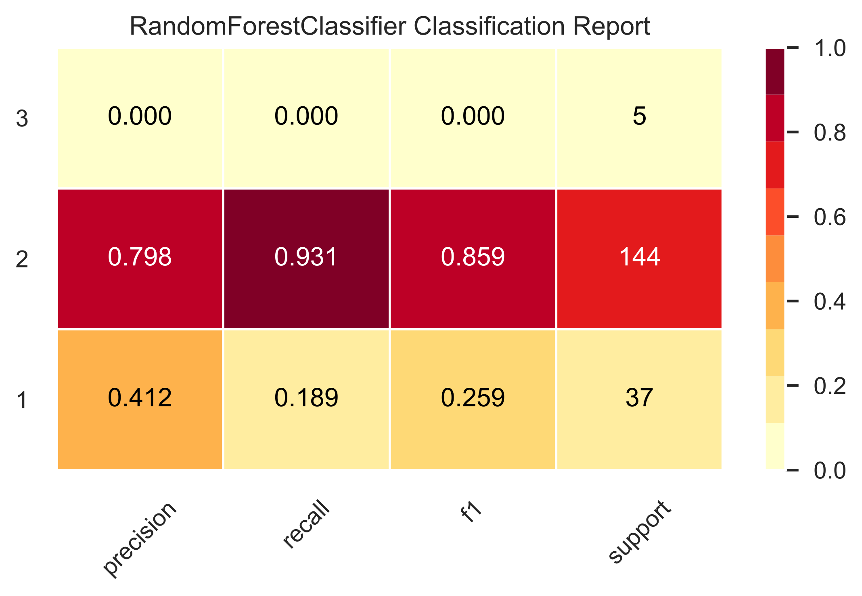
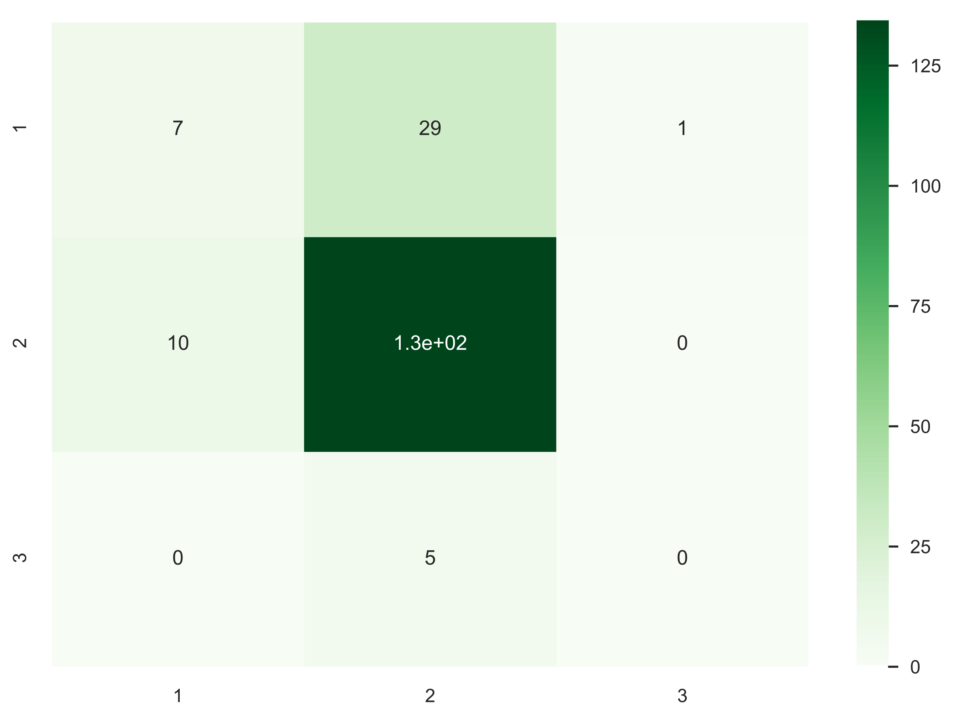
Rating Prediction Results
Confusion matrix
Bad- Rating (0-4]
Ok – Rating (4-8)
Very Good- Rating [8-10]
Mis-classification: A penalty of 1 for “rating down” and 2 for “rating up”

Slide 10
Next Steps
Detect emotions using deep learning methods to improve the sentiment classification
Improve topic modeling by using the entire script and other pre-processing techniques
Include additional features
Movie-based
Release-based
Cast-based
Micro-economic data
Notes:
Although the features extracted from the dialogues by themselves are not sufficient to predict the ratings, they can be used in conjunction with other numeric features to predict success of a movie
Can I do PCA on topics obtained?
Variables have predictive power and can be used in conjunction with numeric features to predict movie performance.
Include the entire script and not just the dialogues which can improve classification of movies.
Issues with modeling conversations:
Example: movie endings are not detected.

